Slide 1

Neighborhood Selection
Comparison of Miami Neighborhoods to Williamsburg, Brooklyn

Slide 2

Introduction
Target Market: People that place high importance on restaurant options and are looking for places to move.
The project will calculate a "foodie" score for each neighborhood in Miami which will incorporate the amount of restaurants within walking distance and their diversity.
The project will also rank the neighborhoods in the target location (Miami) based on how similar they are to the source neighborhood (Williamsburg, Brooklyn) in restaurant offerings.

Slide 3

DATA
Location Data:
The coordinates of Williamsburg are avialable in the newyork_data.json
The names and coordinates of the Miami neighborhoods will be scraped from Wikipedia
Foodie Score:
Number of restaurants within 1000m of each neighborhood coordinate from Foursquare
The names and coordinates of the Miami neighborhoods will be scraped from Wikipedia

Slide 4
Methodology¶
Prepare location data¶
Clean up Miami dataframe:
Create map with Miami Neighboorhoods
Get Restaurant Data¶
Create Foodie score for Miami Neighborhoods¶
Compare Miami neighborhoods to Williamsburg in restaurant profile¶
Create a table with the frequency of each restaurant cuisine in each neighborhood
Create a dataframe of the 10 most common restaurants in each neighborhood in Miami
calculate the Euclidean distance between the each of the Miami neighborhoods and Williamsburg
put these similarity scores on the map

Slide 5
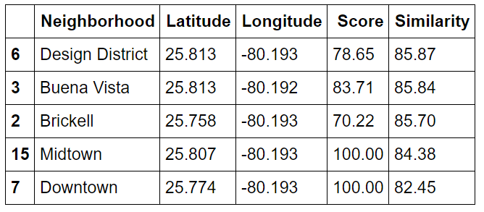
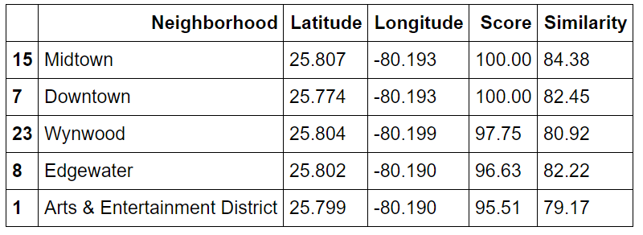
Results
The 5 neighborhoods most similar to Williamsburg are
The 5 neighborhoods with the highest "Foodie Score" are:

Slide 6
Conclusion
The analysis above is done for one source neighborhood and one destination city but could be generalized for any source and destination and even could look for destination neighborhoods in multiple cities. The most important limitation factor is a reliable source of neighborhood information for all cities.

Slide 7

Thank you!
Flora@contoso.com
http://www.contoso.com/

